Slide 1
Amazon Delivery in Boston
INFO6205 – Final Project
Neelesh Saxena

Slide 2
Problem Statement
Amazon is struggling to provide delivery service to its customers.
The problem arises from the fact that there are multiple orders for products in the city, keeping in mind that there are fixed number of transport carriers used to deliver, each carrier can carry some number of deliveries.
What should be the minimal total cost of the number of routes, the minimal/optimal travel length, and the minimal/optimal travel time?

Slide 3
Proposed Solution
The objective here is to minimize the total cost for Amazon, which constitutes the number of routes that each delivery guy takes
Optimizing their delivery route to deliver products keeping in mind each customer is visited only once.
Optimizing the route keeping in mind the time and distance factor
The proposed PSO algorithm has been applied to provide these solutions

Slide 4
Vehicle Routing Problem
Have modeled the Amazon problem into a Vehicle Routing Problem which classify problem related to distribution of goods between depots and users.
The users are geographically scattered across the map and the users can be categorized into customers, retailers, etc.
The distribution of goods is done by one or multiple depots through one or multiple vehicles
My model takes distribution to multiple user through vehicles from a single depot.

Slide 5
Particle Swarm Optimization
An iterative function that searches over a search space with embedded particles.
Particles calculate their fitness value over each iteration.
Each particle determines its movement by combining their current fitness value, previous fitness values and the global fitness values.
In short the particles update their position with the help of other particles keeping a swarm like movement.
The next iteration starts after the positions of all particles have been updated

Slide 6
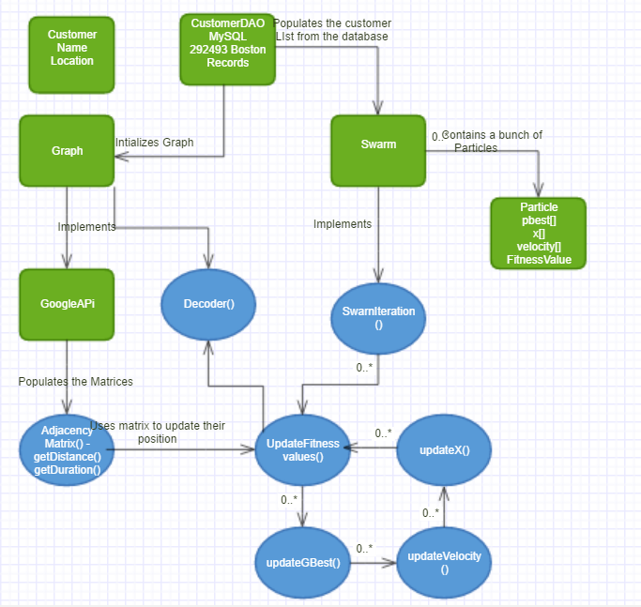
Classes and definitions

Slide 7
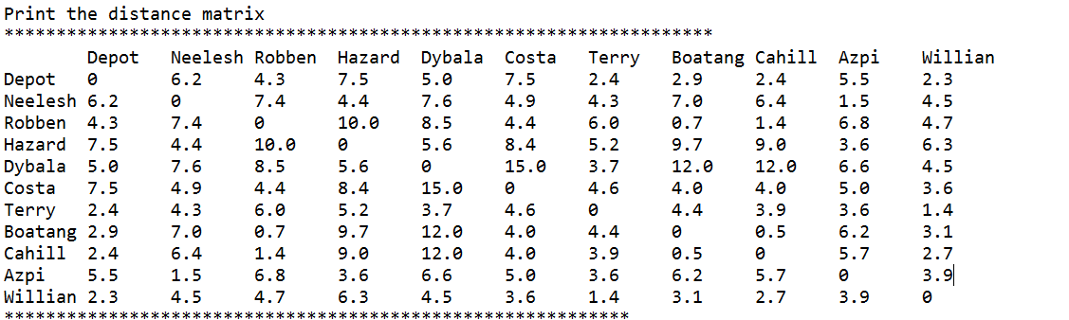
Example Simulation
Chose 10 customers with random addresses scattered through Boston through MySQL database.
Initialization –
First I initialize my adjacency matrix for keeping the distances between all the edges. I have used Google Distance Matrix API for retrieving the actual distance (miles) and duration (minutes).

Slide 8
Suppose the number of particles, say N, are set to 3. Particles are now initialized with initial solutions (randomly shuffled route sequences)
Here the values in X represent the customers, like 1.0 is the first customer in my main customer list. It has been encoded to form a route congigration.
X1 = [3.0, 2.0, 6.0, 8.0, 1.0, 4.0, 7.0, 10.0, 5.0, 9.0] (route configurations)
V1 = [9.65, 6.87, 0.29, 0.43, 3.53, 6.12, 9.9, 1.85, 0.32, 2.34] (randomly generated between 0 – number of customers)

Slide 9
Fitness Value
Keeping in mind my problem of delivering amazons goods by reducing the cost and minimizing the distance and duration and finding the optimal path, I pick up each route (X for each particle) decode the actual path and calculate the distance and duration for that route, add them up and update my fitness value if the current one is less than the previous best.
Each time the fitness values are changed for each particle, the fitness values are checked against gBest (global best route with minimized distance and duration), and if the current X is less than the gBest, it is updated with fitness value and route as shown below.
This is how the communication between particles occurs.

Slide 10

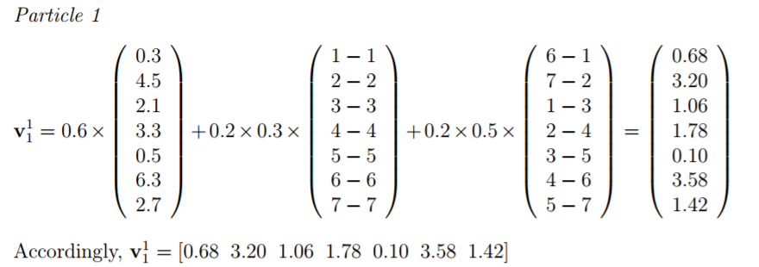
Velocity updating
The velocity array is continuous numbers between 0 and number of customers. The velocity arrays are initially initialized randomly. For all the following iterations, the below formula has been used for updating the velocity

Slide 11

X vector Updating
The equation is used to calculate the new X (route) for each particle

Slide 12
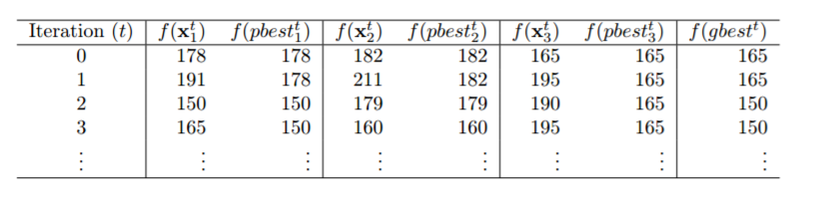
Swarm Iterator
Calls updateFitnessValues()
Calss updateGbest()
Calls udpateVelocity()
Calls update()

Slide 13
Suppose after the final iteration, the gBest array holds
X = [5.9,7.9,7.8,7.3,5.93,7.38,9.39,10.0,6.9,4.26]
The route for this is calculated based on ranks. The lowest value, 4.26 is the first customer to be serviced, customer with the value 5.9 would be selected next and so on. In case of similar ranks, the velocity array is referenced, and the minimum value between the similar values is serviced first.
Decode into

Slide 14
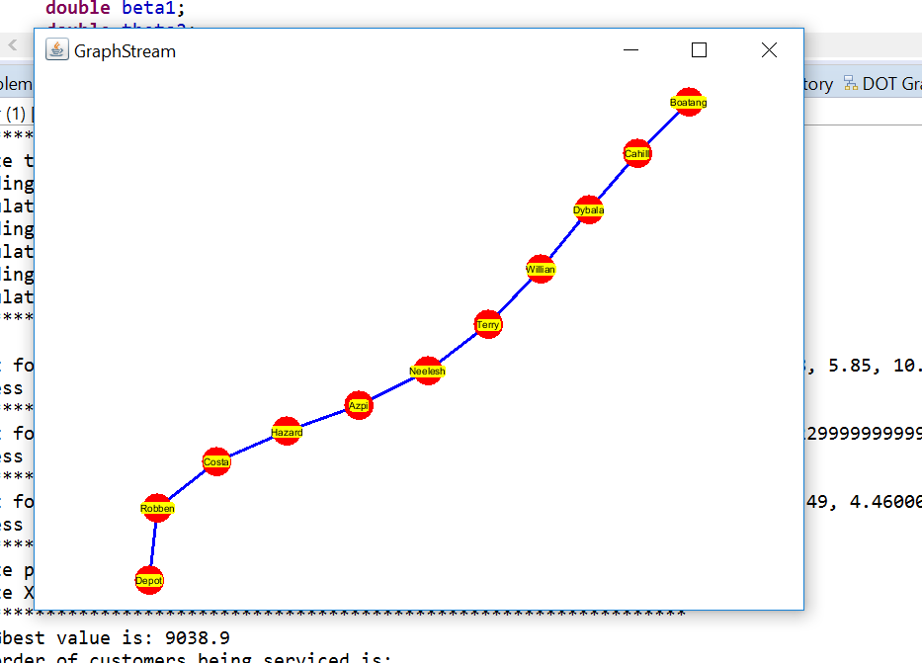

Slide 15
Analysis
Two major points that were notices in the trend:
Increasing just the number of particles does not necessarily improve the results
Increasing the iterations to 100+, provides a better result as compared to iterations less than 100.
Increasing the number of particles to more than 500 and number of iterations to more than 700, definitely provides the best results for the chosen 10 customers.

Slide 16
